Slide 1
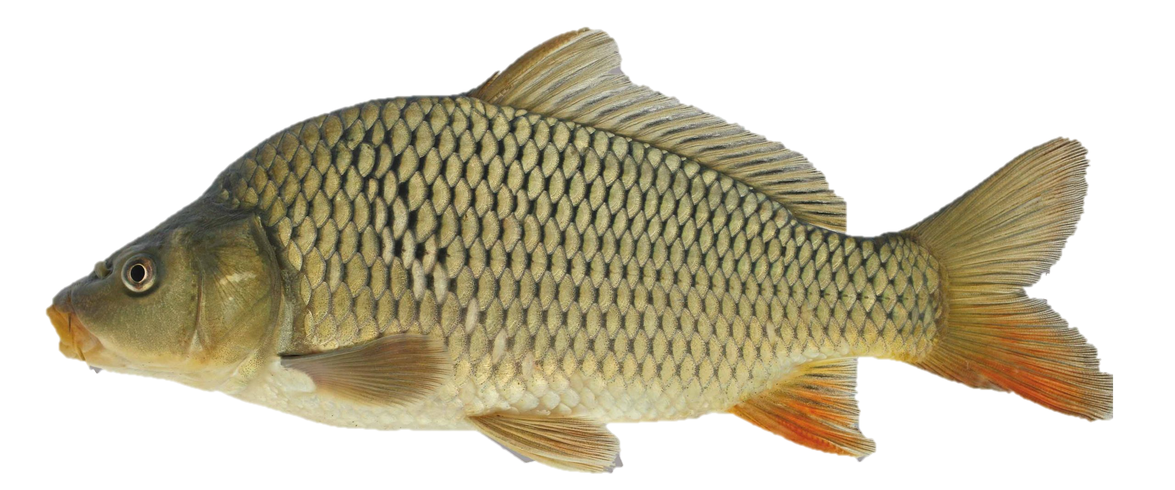
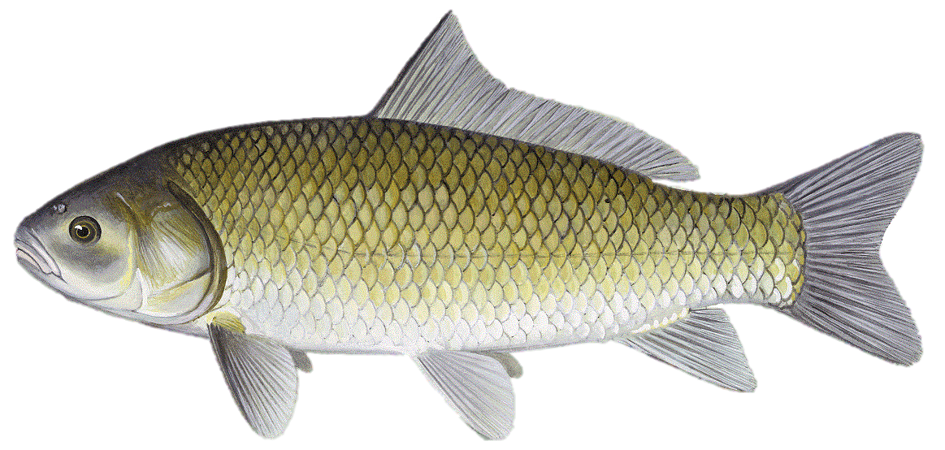
Common carp removed (kg/ha)
Bigmouth Buffalo removed (kg/ha)
Summer 18
Summer 19
Summer 20
Summer 18
Summer 19
Summer 20
Blue
0
0
0
0
0
0
South Twin
0
0
0
0
0
0
Storm
0
0
0
0
0
0
Center
23
12
222
61
0
0
Five Island
15
19
17
185
0
0
17
13
365
276
North Twin
0
0
Silver
10
71
65
74
0
0

Slide 2
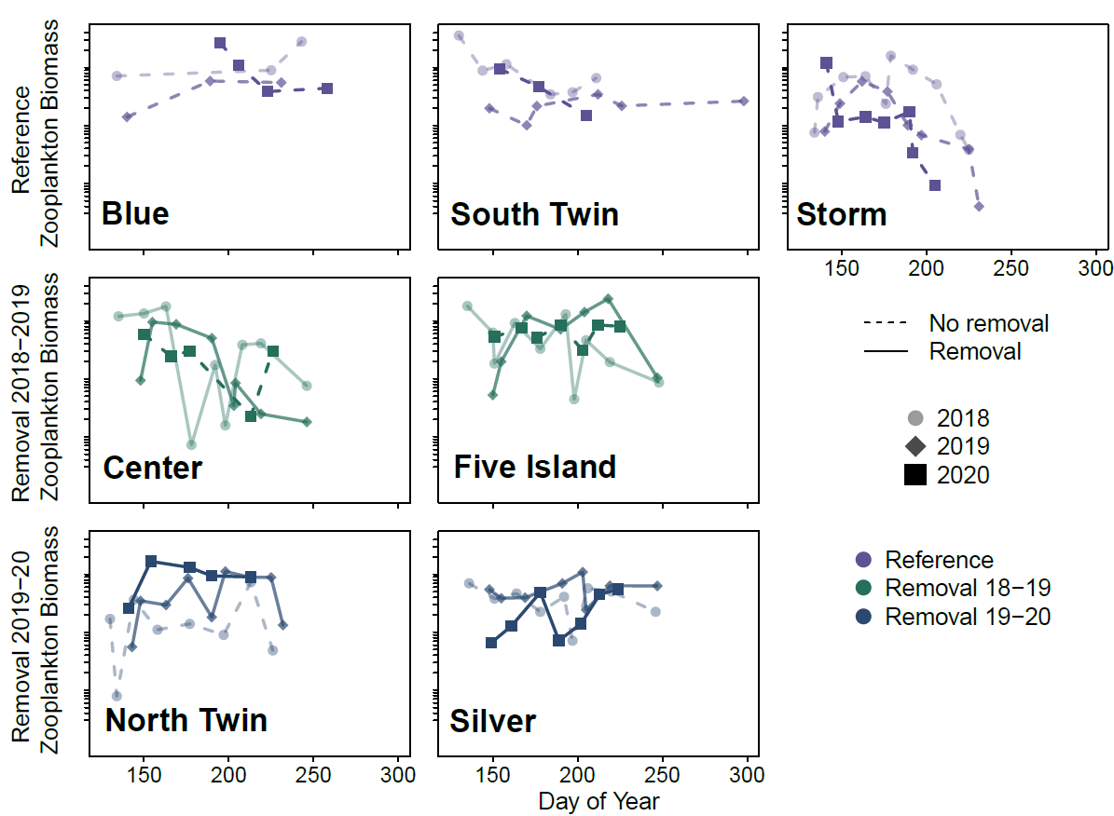
Zooplankton biomass the year after removal stays roughly elevated except for Silver Lake which reflects the pre-removal conditions

Slide 3
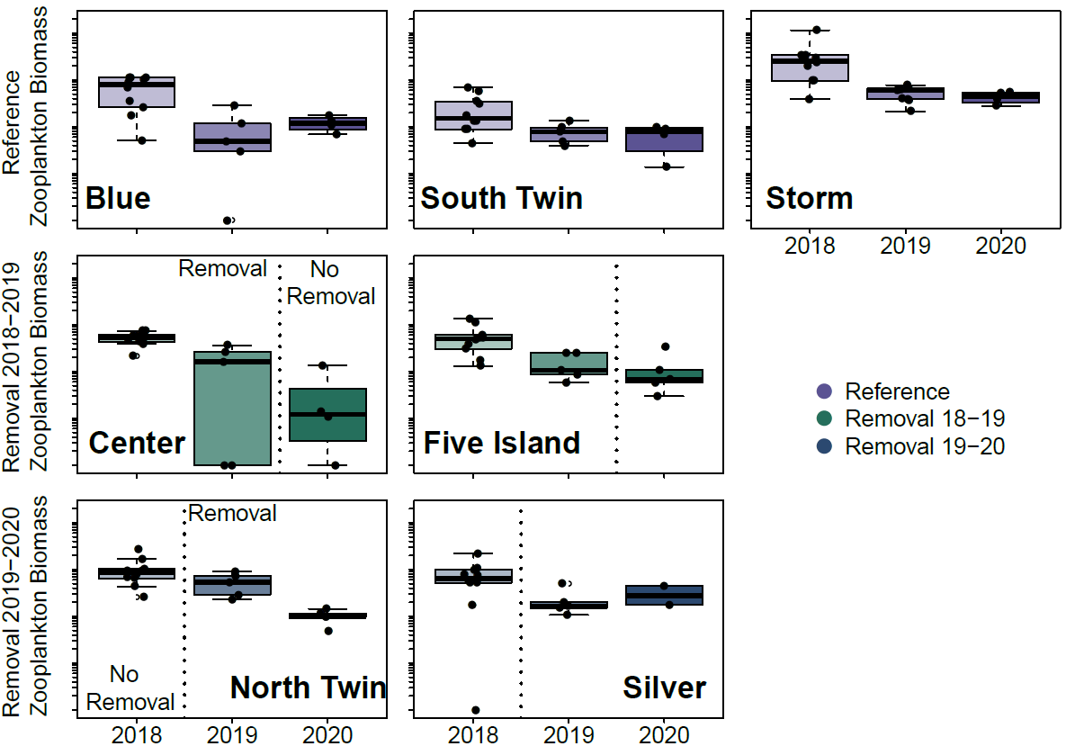
Did not see much of an effect in macroinvertebrate density, rather all lakes had a general decline.

Slide 4
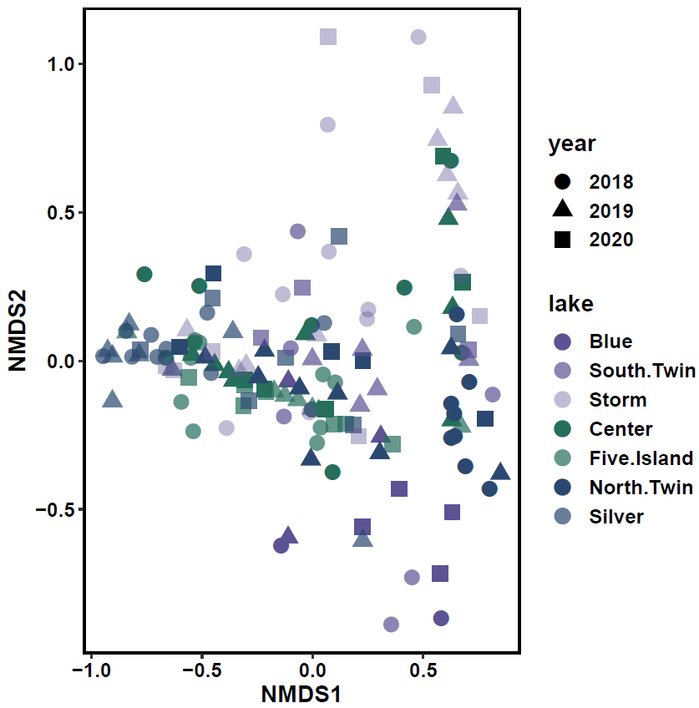
Saw some similarity of zooplankton community composition within lake groups Difference among years less clear
Reference
Removal 18 - 19
Removal 19 - 20

Slide 5
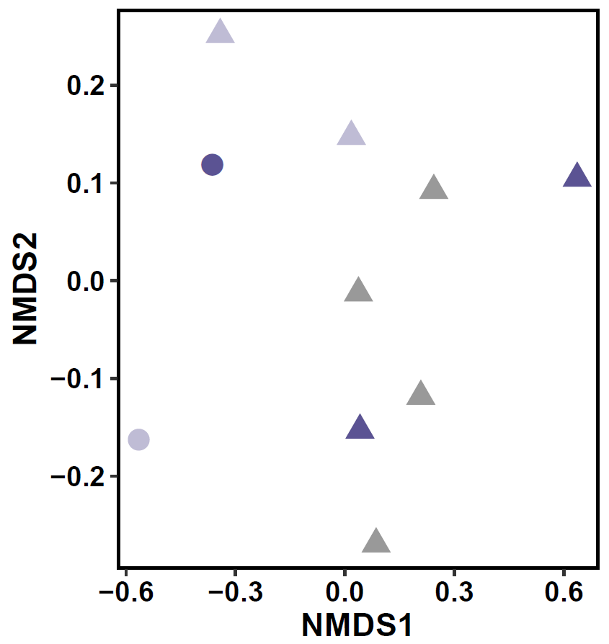
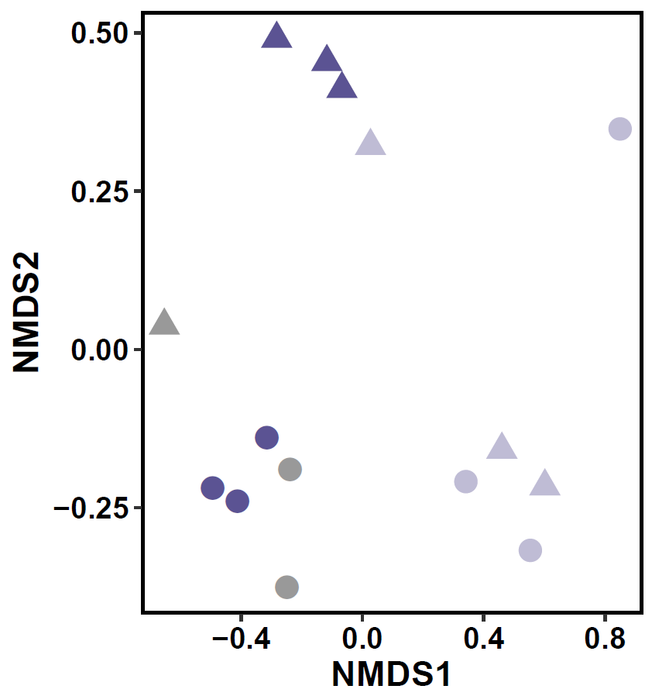
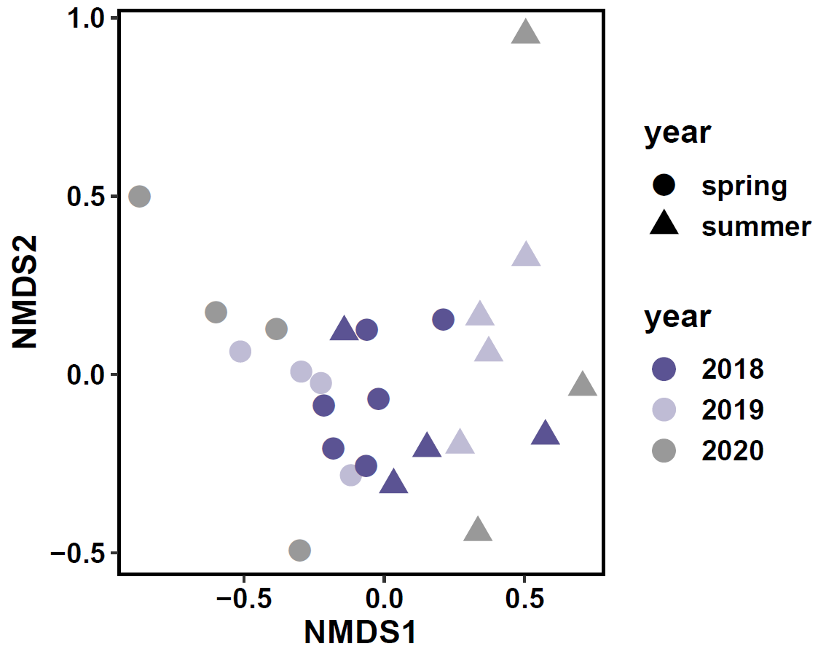
Reference
Blue
South Twin
Storm

Slide 6
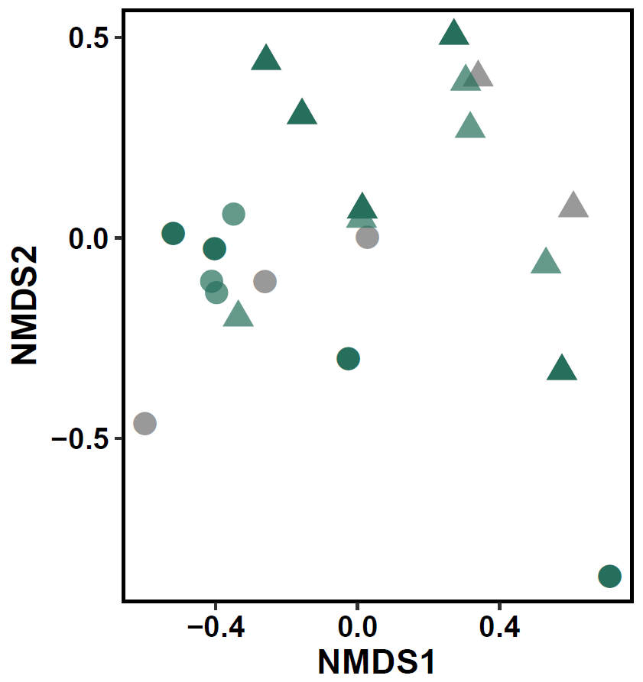
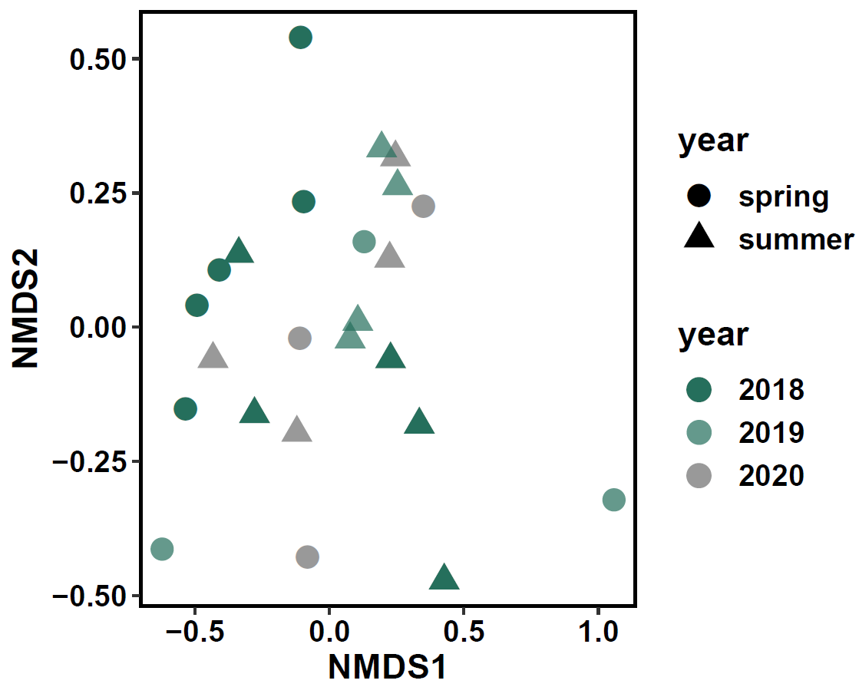
Removal 18 - 19
Center
Five Island

Slide 7
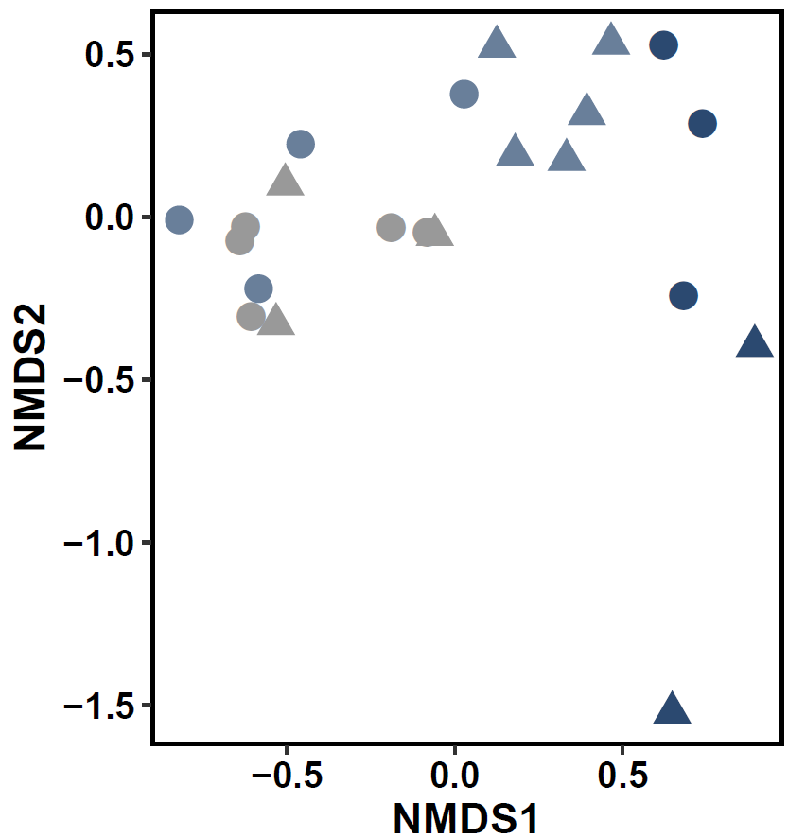
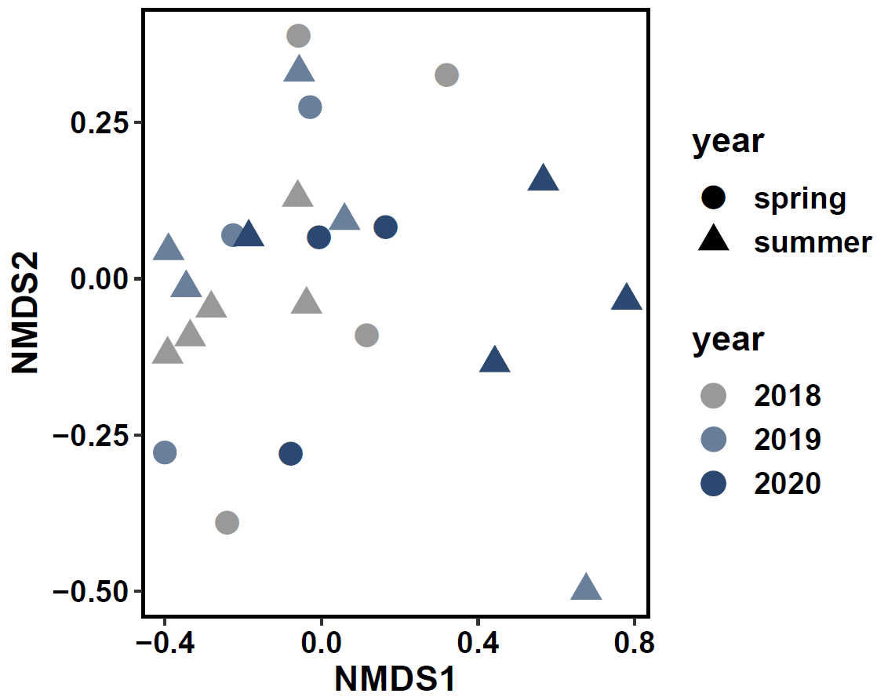
Removal 19 - 20

Slide 8
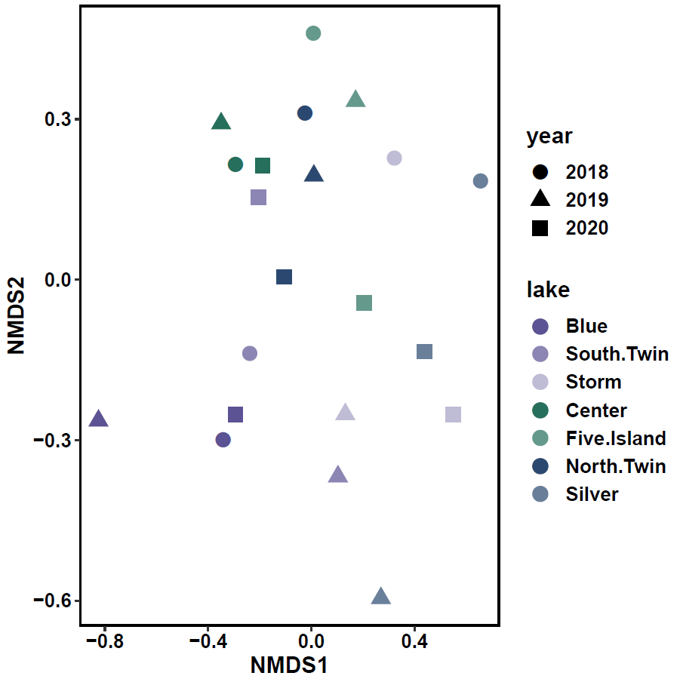
Some movement to right in lakes that had removal in 2018 – 2019
Otherwise not a significant pattern emerging
Reference
Removal 18 - 19
Removal 19 - 20

Slide 9
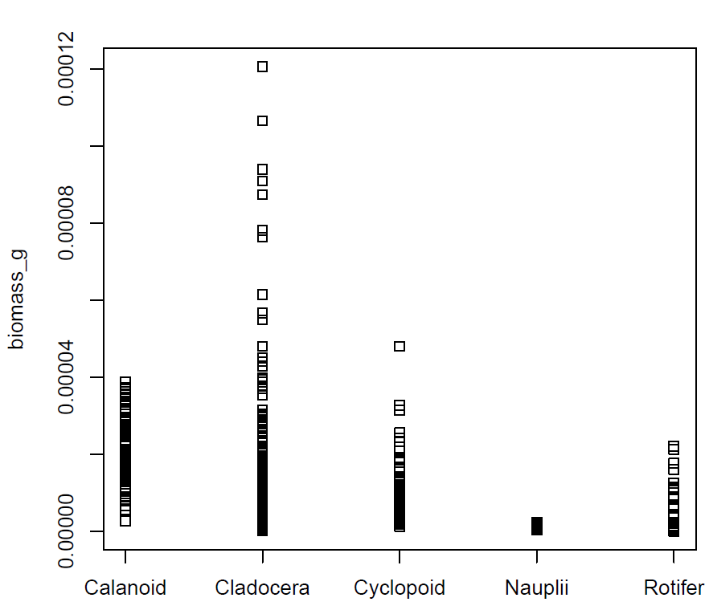
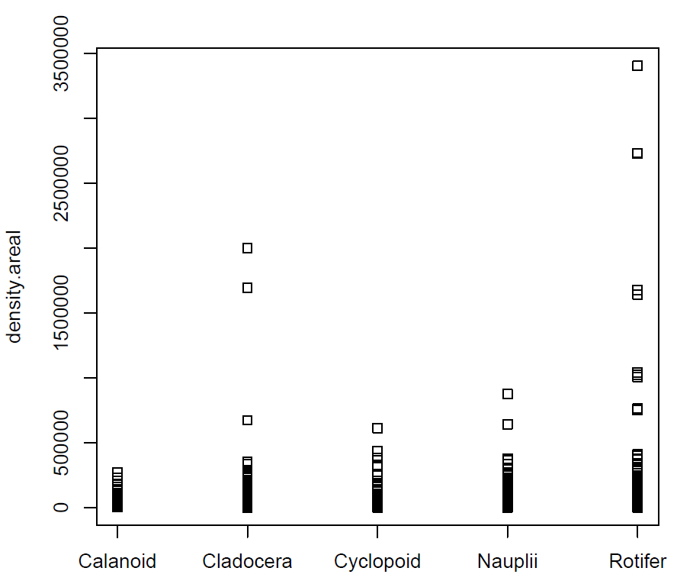
Biomass Distribution
Density Distribution

Slide 10
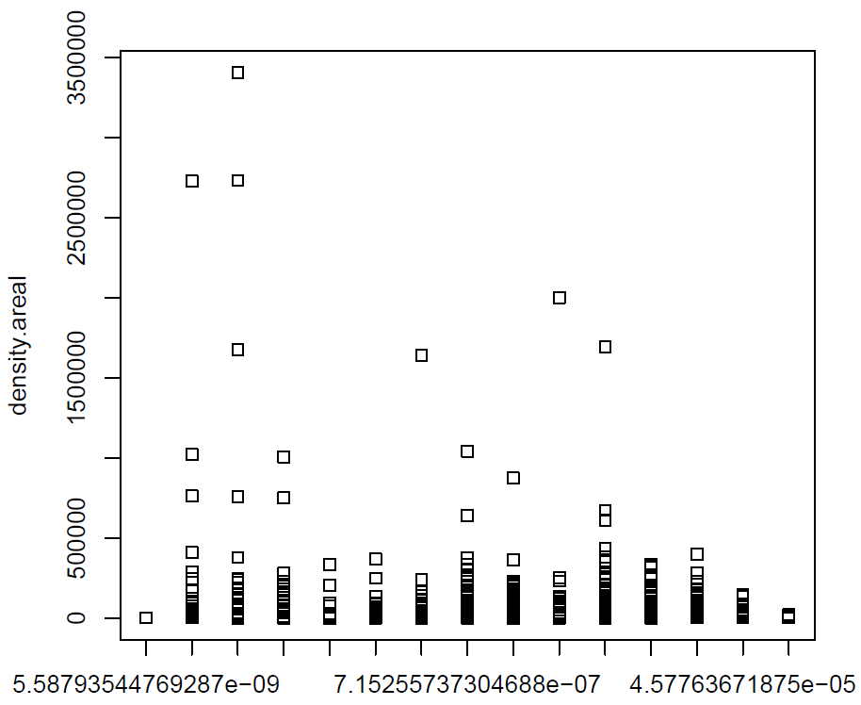
Data post-binning
Areal Density
Biomass Bins

Slide 11
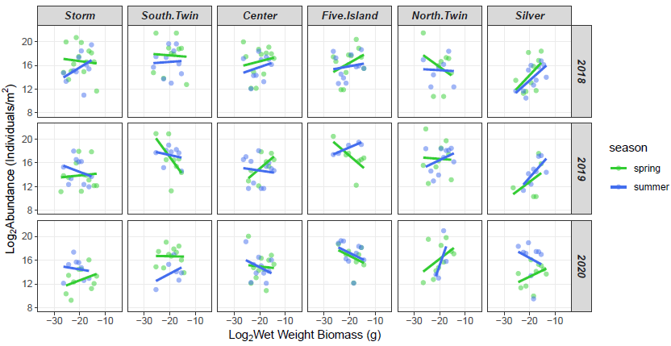

Removal
2018 - 2019
Removal
2019 - 2020
Reference
Fish removal prior to data collection

